Slide 1
Figures and Supplementary Figures (in the order that they appear in the manuscript text):
SuppFigure_Disease and week of delivery
SuppFigure_Glycaemic control during first, second and third (before delivery) trimesters in women with T1D
SuppFigure_Newborn weight distribution
SuppFigure_Glucose level measurements over time in newborns of women with T1D
SuppFigure_Ind_Glucose level measurements over time in newborns of women with T1D
SuppFigure_No correlation between the glycated hemoglobin level in women with T1D and the level of glucose in newborns
Figure_Alpha diversity estimates
Figure_Beta Diversity PCoA plots comparing the T1D and control samples
SuppFigure_Delivery week_Beta diversity
Figure_Microbiota relative abundance in the 3 vaginal sampling sites
Figure_Differentially expressed microbiota (genera) associated with T1D
Figure_Taxa_shared_maternal - neonatal dyads
Figure_Mosaic plot of T1D Dataset
Figure_Pathways_all_samples
Figure_Pathways_Women_rectum swabs_a heatmap?
Figure_Top_pathways_shared_maternal - neonatal dyads
SuppFigure_Comparison of Lactobacillus, Bifidobacterium, and Streptococcus genera rel. abundances by disease and probiotic food products consumed during pregnancy
SuppFigure_Venn diagrams_maternal - neonatal dyads
SuppFigure_energy_prot_Beta diversity

Slide 2
Tables and Supplementary Tables (in the order that they appear in the manuscript text):
Table_clinical_characteristics_women
Table_clinical_characteristics_neonates
SuppTable_Delivery week_Beta diversity
Table_Differentially expressed microbiota (genera) associated with T1D
Table_Beta Diversity Bray Curtis adonis permanova of VST transformed counts versus Delivery mode stratified by sample type
Table_Beta Diversity Bray Curtis adonis permanova of VST transformed counts versus Antibiotics stratified by sample type
SuppTable_SupplementsTaken_Women
SuppTable_Pathways_AllMaterials
SuppTable_taxonomic_contribution_selected pathways
SuppTable_energy_prot_Beta diversity

Slide 3
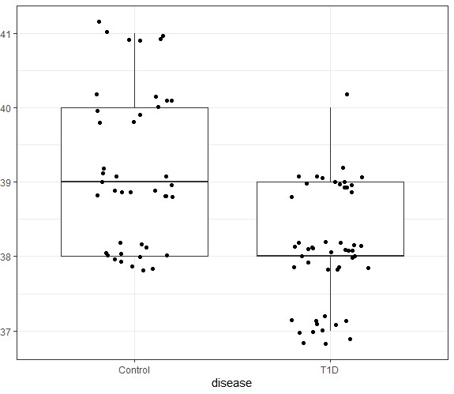
SuppFigure_Disease and week of delivery (perhaps studied groups instead of disease )
p <0.0001 ***
DELIVERY WEEK
Notes:
SuppFigure_Disease and week of delivery.
The box plot presents the differences in the gestation (weeks) between women with T1D and unaffected women (P<0.0001).
Each dot represents one woman.

Slide 4
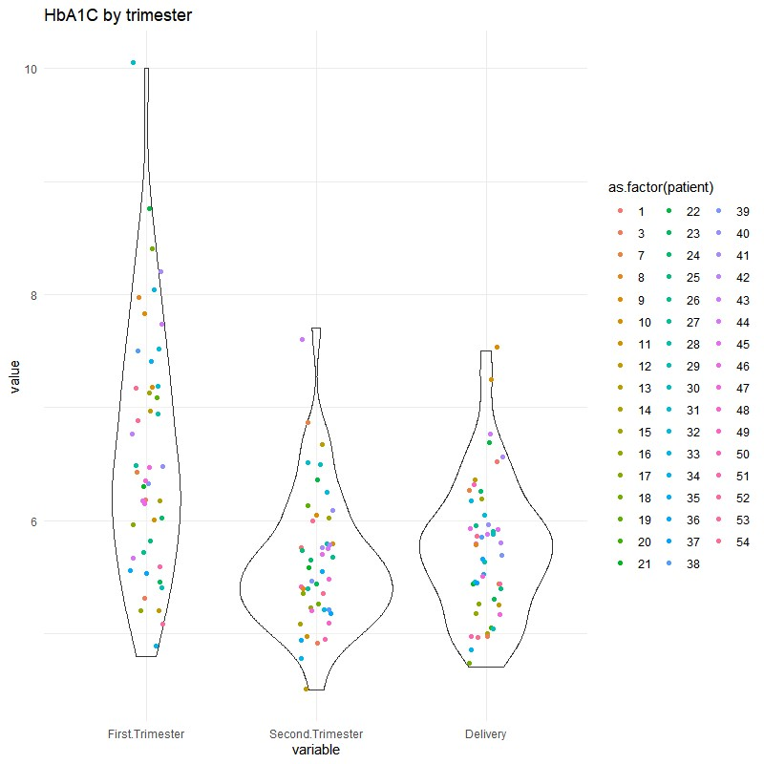
SuppFigure_Glycaemic control during first, second and third (before delivery) trimesters in women with T1D
Tukey multiple comparisons of means [95% family-wise confidence level]
Variable diff lwr upr p adj
Second.Trimester-First.Trimester -0.9936170 -1.3829062 -0.6043278 0.0000000
Delivery-First.Trimester -0.8586383 -1.2420437 -0.4752329 0.0000013
Delivery-Second.Trimester 0.1349787 -0.2484267 0.5183841 0.6826300
Notes:
SuppFigure_Glycaemic control during first, second and third (before delivery) trimesters in women with T1D.
The HbA1C levels measured during first, second and third (before delivery) trimesters in women with T1D.
Each dot represents one woman with T1D.
The glycaemic control was found to be satisfactory in second and third trimesters (in accordance with the recommendations of the Polish Diabetes Association, HbA1C ≤ 6.0% (42 mmol/mol)). The Tukey multiple comparisons of means show that no substantial difference in the results of diabetes control when comparing the data of the second and third trimesters of pregnancy (P= 0.682) was found.

Slide 5
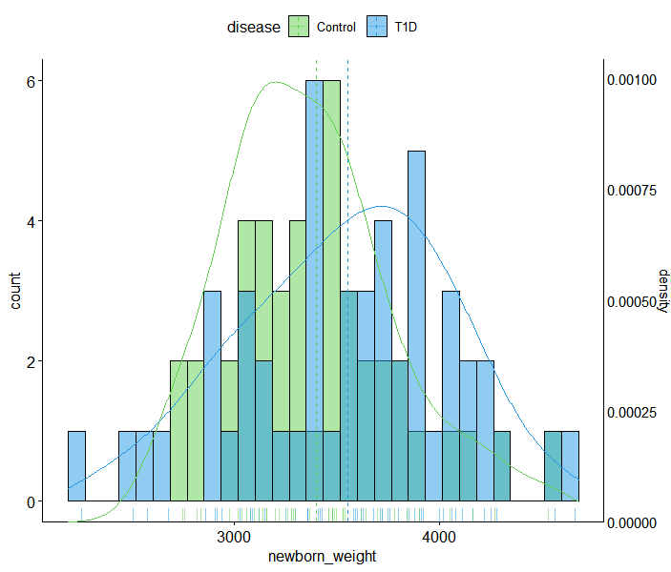
SuppFigure_Newborn weight distribution
Notes:
SuppFigure_Newborn weight distribution.
Newborns born to mothers with T1D had higher body weight (in grams), which is indicated by the Gaussian curve shift to the right (P=0.0947).

Slide 6
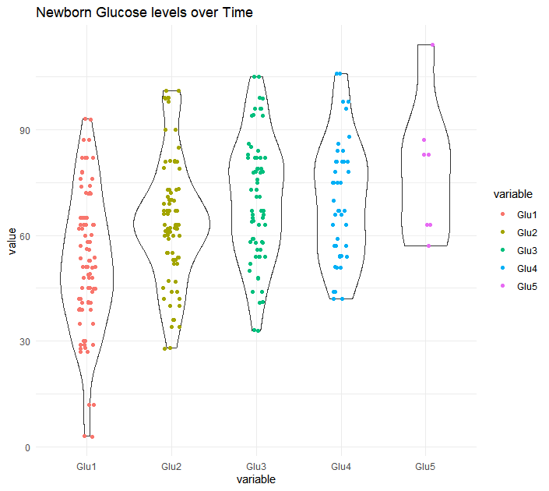
SuppFigure_Glucose level measurements over time in newborns of women with T1D
blood glucose level [mg/dl]
Notes:
SuppFigure_Glucose level measurements over time in newborns of women with T1D.
The measurements of plasma glucose level [mg/dl] in two to five time points (the number of measurements depended on the condition of the newborn), performed in newborns born to women with T1D.

Slide 7
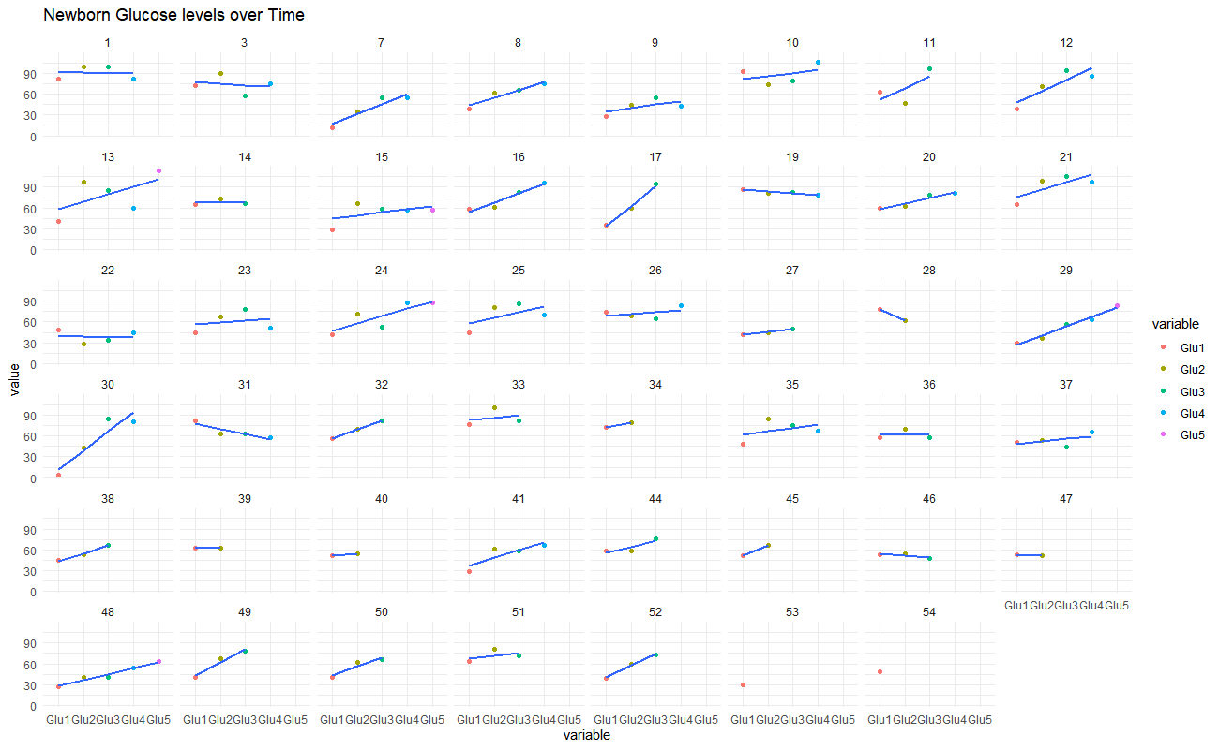
SuppFigure_Ind_Glucose level measurements over time in newborns of women with T1D
Notes:
30 July 2020
SuppFigure_Ind_Glucose level measurements over time in newborns of women with T1D.
The measurements of plasma glucose level [mg/dl] in two to five time points (the number of measurements depended on the condition of the newborn), performed in newborns born to women with T1D, presented in 50 individual graphs corresponding to 50 newborns of women with T1D.
If a figure is selected for this publication, it must be changed to 50 neonates reported in this ms.

Slide 8
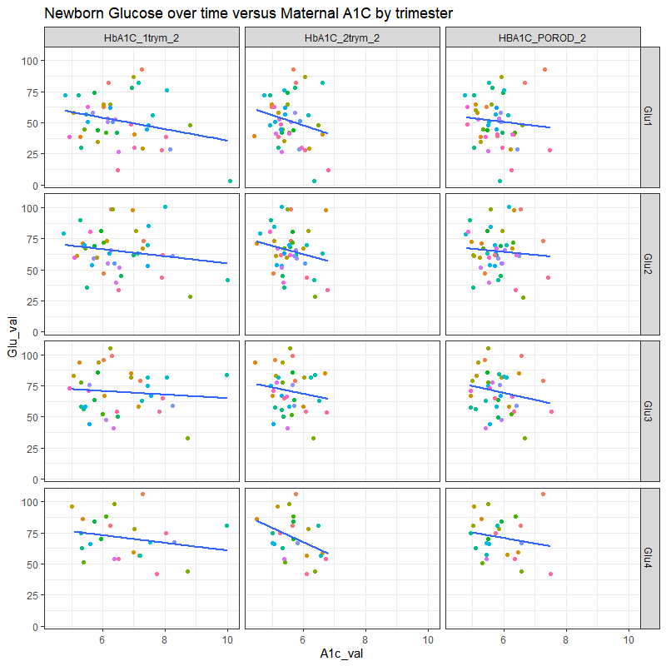

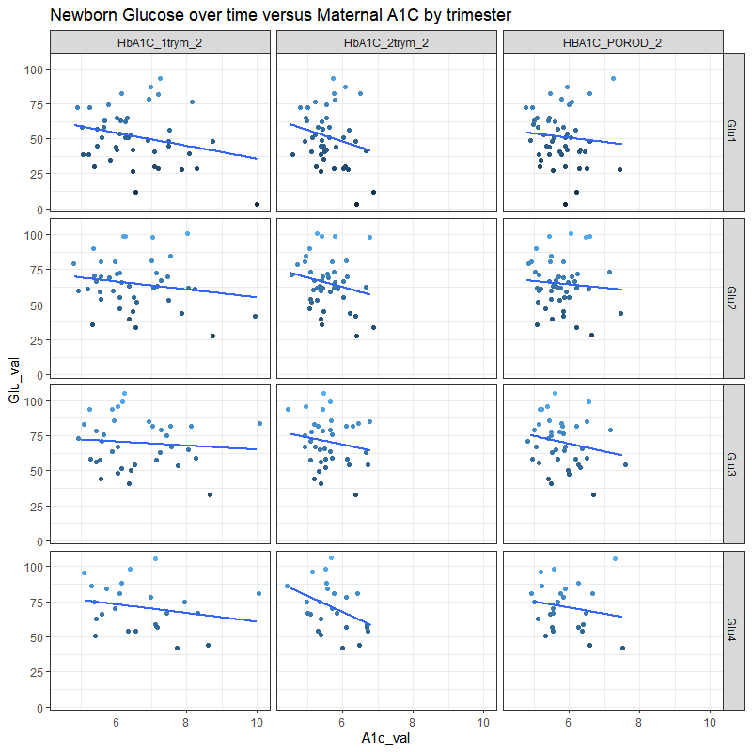
SuppFigure_No correlation between the glycated hemoglobin level in women with T1D and the level of glucose in newborns
Pearson's product-moment correlation
between Delivery HBA1c and glucose timepoint 1
data: Delivery HBA1c and glu1
t = -0.62595. df = 45. p-value = 0.5345
alternative hypothesis: true correlation is not equal to 0
95 percent confidence interval:
-0.3701970 0.1995847
sample estimates:
cor -0.09290696
Linear regression model for Delivery HBA1c and the interaction effects of glucose timepoints 1-4.
Coefficients:
Estimate Std. Error t value Pr(>|t|)
(Intercept) 3.883e+00 3.888e+00 0.999 0.326
Glu1 5.544e-02 7.791e-02 0.712 0.482
Glu2 8.776e-02 7.135e-02 1.230 0.228
Glu3 2.546e-02 5.433e-02 0.469 0.643
Glu1:Glu2 -1.793e-03 1.271e-03 -1.411 0.168
Glu1:Glu3 -7.781e-04 1.037e-03 -0.751 0.459
Glu2:Glu3 -1.179e-03 9.474e-04 -1.245 0.223
Glu1:Glu2:Glu3 2.422e-05 1.622e-05 1.493 0.146
(Dispersion parameter for gaussian family taken to be 0.3251273)
Null deviance: 13.530 on 38 degrees of freedom
Residual deviance: 10.079 on 31 degrees of freedom
(100 observations deleted due to missingness)
AIC: 75.906
Number of Fisher Scoring iterations: 2
Notes:
SuppFigure_No correlation between the glycated hemoglobin level in women with T1D and the level of glucose in newborns.
The correlation between the glycated hemoglobin level in women with T1D measured before delivery and the level of glucose in newborns born to these women. No correlations using Pearson's product-moment test were found regarding HbA1C levels of mothers with T1D, in first, second and third (delivery) trimesters, and first measurement of glucose level in newborns.

Slide 9
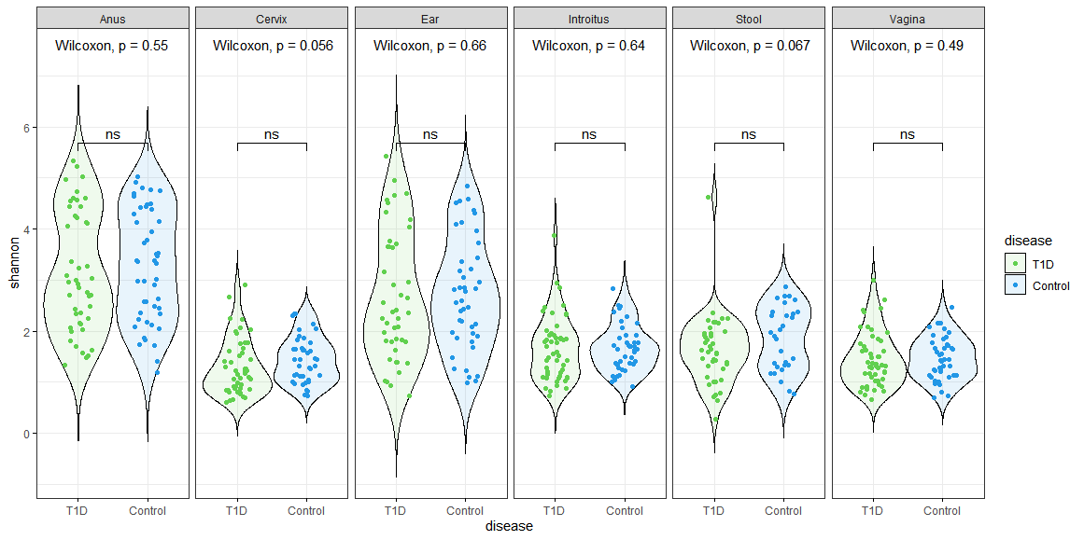
Figure_Alpha diversity estimates
library(microbiome)
library(ggpubr)
sam<-data.frame(sample_data(ASV_physeq_core))
alpha<-alpha(x = ASV_physeq_core.index = "shannon")
sam$shannon<-alpha$diversity_shannon
ggviolin(sam. x = "disease". y = "shannon". fill = "disease".
palette =c("#61D04F"."#2297E6").theme_bw()+
add = "boxplot". add.params = list(fill = "white"))+
stat_compare_means(comparisons = my_comparisons. label = "p.signif")+ # Add significance levels
stat_compare_means(label.y = 10) +facet_grid(facets = ~SampleType) # Add global the p-value
Notes:
Figure_Alpha diversity estimates.
The Alpha diversity (Shannon index) of maternal vaginal introitus, vaginal canal in the middle, cervix and rectum swabs, as well as neonatal ear-skin swabs and stool samples.
The Wilcoxon test showed no significant differences in species abundance in terms of maternal disease status.

Slide 10
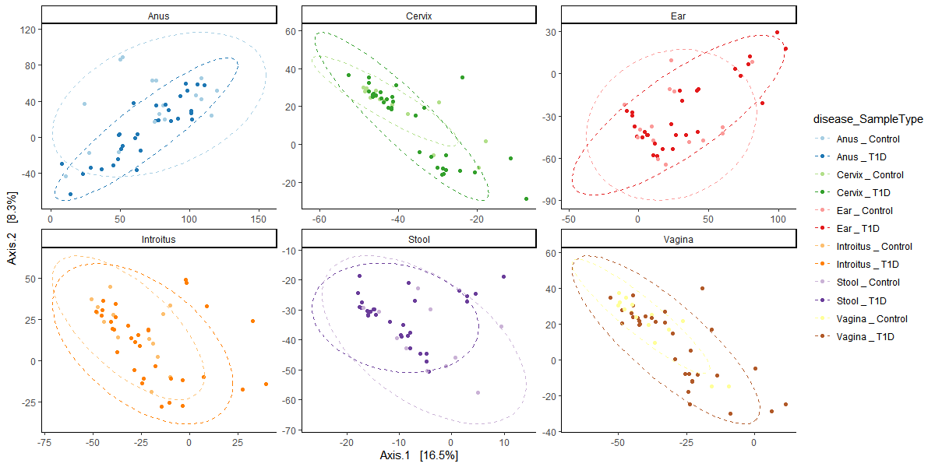
Figure_Beta Diversity PCoA plots comparing the T1D and control samples
across all microbiome sample types
Notes:
Figure_Beta Diversity PCoA plots comparing the T1D and control samples.
Beta Diversity PCoA plots showing the microbial composition of T1D and control samples in all tested sample types.

Slide 11
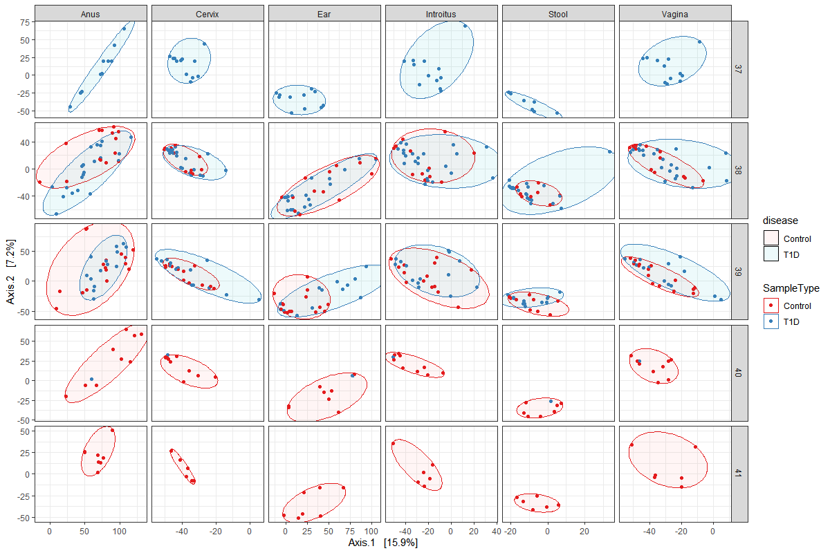
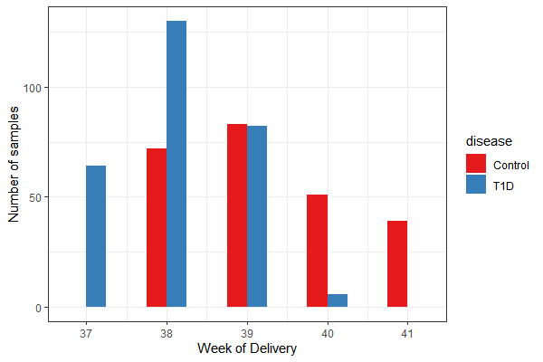
SuppFigure/Table_Delivery week_Beta diversity
Table X. Beta Diversity Bray Curtis adonis permanova of VST transformed counts versus week of delivery stratified by sample type.
 | Df | SumsOfSqs | MeanSqs | F.Model | R2 | Pr(>F)
disease | 1 | 23963 | 23963 | 1.9261 | 0.00377 | 0.0001 | ***
week of delivery | 1 | 18700 | 18700 | 1.5031 | 0.00294 | 0.0024 | **
disease:week of delivery | 1 | 18144 | 18144 | 1.4584 | 0.00285 | 0.002 | **
Residuals | 506 | 6295123 | 12441 |  | 0.99043
Total | 509 | 6355930 |  |  | 1
Signif. codes: 0 ‘***’ 0.001 ‘**’ 0.01 ‘*’ 0.05 ‘.’ 0.1 ‘ ’ 1
Notes:
2 in 1
SuppFigure_Delivery week_Beta diversity.
The Beta Diversity PCoA plots presenting the T1D and control samples’ microbial composition across all studied sample types regarding delivery week. The influence of delivery week was found to affect the microbial composition (P=0.0024) in the assessed samples.
SuppTable_Delivery week_Beta diversity

Slide 12
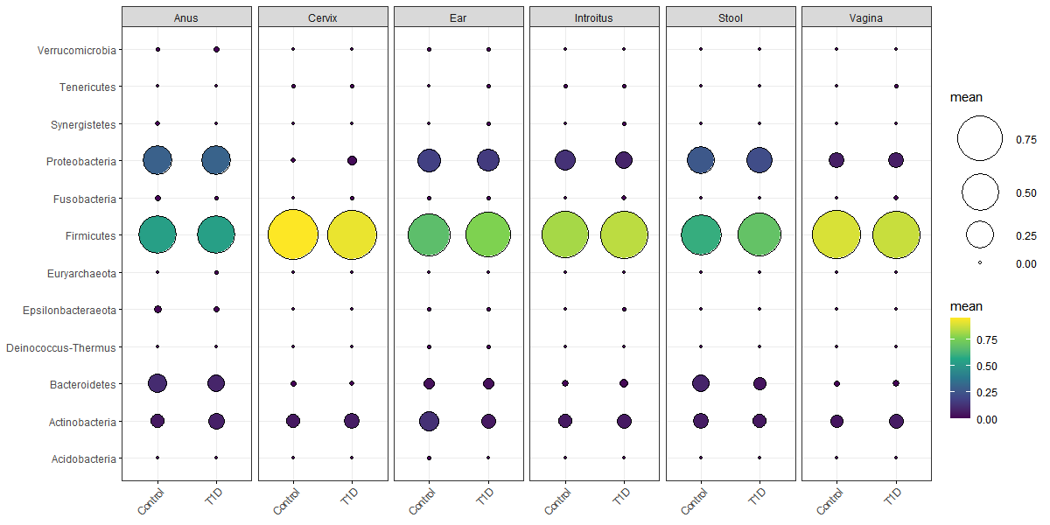
Figure_Microbiota relative abundance_Phylum_in the 3 vaginal sampling sites
Mean relative abundance
Notes:
Microbiota relative abundance. All materials, separately
Just to remind; Cervix – low variability of bacteria; Firmicutes increase trend: introitus – mid vagina – cervix
Figure_Microbiota relative abundance in the 3 vaginal sampling sites.
The mean relative abundance of 12 most prevalent phyla (Verrucomicrobia, Tenericutes, Synergistetes, Proteobacteria, Fusobacteria, Firmicutes, Euryarcheota, Epsilonbacteraeota, Deinococcus-Thermus, Bacteroidetes, Actinobacteria and Acidobacteria) across all studied sample types. The Firmicutes, Proteobacteria, Actinobacteria and Bacteroidetes dominated among the 12 examined phyla.
The differences in phylum relative abundance in the 3 assessed vaginal sampling sites were found. The low variability of bacteria near the cervix and the ascendent trend of phylum Firmicutes, increasing from introitus through the center of the vagina to the cervix were found in both T1D and control women. No substantial differences in phylum relative abundance in the materials derived from neonates were found.

Slide 13
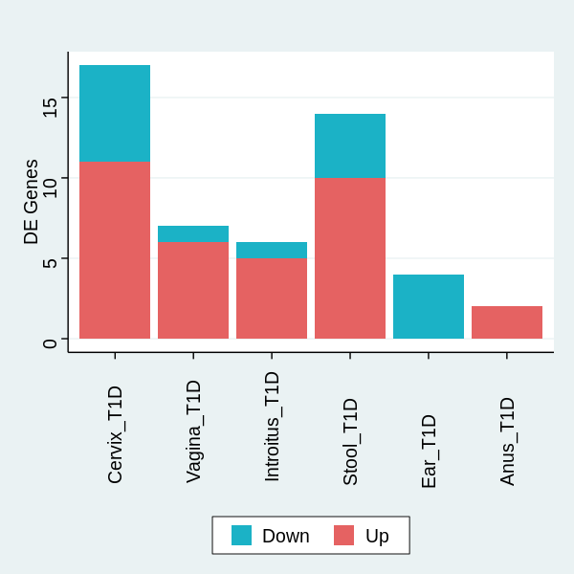
Table/Figure_ Differentially expressed microbiota (genera) associated with T1D
Vagina |  |  |  |  |  |  |  | Infant Stool
Genus | baseMean | log2FoldChange | lfcSE | stat | pvalue | padj |  | Genus | baseMean | log2FoldChange | lfcSE | stat | pvalue | padj
Sneathia | 0.91355325 | 49.75205694 | 3.13553 | 15.86719 | 1.07E-56 | 2.44E-54 |  | Fusicatenibacter | 4.220115 | 26.4382456 | 1.231132084 | 21.47474 | 2.68E-102 | 3.03E-100
Intestinibacter | 2.25394947 | 14.81940553 | 1.300908 | 11.39159 | 4.61E-30 | 5.25E-28 |  | Fusobacterium | 8.180648 | 20.08683224 | 1.35277147 | 14.84865 | 7.10E-50 | 4.01E-48
Atopobium | 96.63138911 | 6.817629914 | 1.005162 | 6.782617 | 1.18E-11 | 8.97E-10 |  | Megasphaera | 3.663976 | 15.61100439 | 1.620942737 | 9.630818 | 5.93E-22 | 2.23E-20
Megasphaera | 3.663975758 | 7.795750046 | 1.382241 | 5.639935 | 1.70E-08 | 9.70E-07 |  | Anaeroglobus | 2.730555 | 19.46259187 | 2.232914701 | 8.716227 | 2.88E-18 | 8.13E-17
Streptococcus | 1247.347326 | -3.575171258 | 0.710685 | -5.0306 | 4.89E-07 | 2.23E-05 |  | Pseudomonas | 5.238713 | 7.50531745 | 0.927683487 | 8.090386 | 5.95E-16 | 1.34E-14
Gemella | 7.791854732 | 7.025311314 | 1.569641 | 4.475743 | 7.61E-06 | 0.000289 |  | Collinsella | 5.822142 | -8.766264106 | 1.128939518 | -7.76504 | 8.16E-15 | 1.54E-13
Prevotella_6 | 30.81174732 | 3.78113307 | 0.950575 | 3.977733 | 6.96E-05 | 0.002266 |  | Romboutsia | 2.192765 | 6.40497023 | 1.202747682 | 5.325282 | 1.01E-07 | 1.63E-06
Introitus |  |  |  |  |  |  |  | Peptoniphilus | 132.7484 | 3.420168182 | 0.746132643 | 4.583861 | 4.56E-06 | 6.45E-05
Genus | baseMean | log2FoldChange | lfcSE | stat | pvalue | padj |  | Terrisporobacter | 2.507783 | -7.662802823 | 1.690229063 | -4.53359 | 5.80E-06 | 7.28E-05
Gemella | 7.791854732 | 21.37686055 | 1.594903 | 13.40323 | 5.79E-41 | 1.32E-38 |  | Sutterella | 3.176991 | -5.191498608 | 1.197334093 | -4.33588 | 1.45E-05 | 0.00016405
Citrobacter | 13.1186876 | 15.31044525 | 1.496272 | 10.2324 | 1.42E-24 | 1.62E-22 |  | Dialister | 33.95076 | 3.498783559 | 0.957451276 | 3.654268 | 0.000258 | 0.002649509
Terrisporobacter | 2.507782593 | 14.70171656 | 1.528636 | 9.617539 | 6.74E-22 | 5.12E-20 |  | Bacteroides | 325.9302 | -3.032249963 | 0.875592579 | -3.46308 | 0.000534 | 0.005028719
Enhydrobacter | 2.725316164 | -5.10656261 | 0.868546 | -5.87944 | 4.12E-09 | 2.35E-07 |  | Actinomyces | 7.449215 | 2.884909904 | 0.849028514 | 3.397895 | 0.000679 | 0.005902636
Klebsiella | 110.8625127 | 7.790694435 | 1.360577 | 5.726023 | 1.03E-08 | 4.69E-07 |  | Lachnoclostridium | 1.616491 | 3.844592112 | 1.188055273 | 3.236038 | 0.001212 | 0.009782669
Staphylococcus | 11942.16678 | 2.430468841 | 0.578343 | 4.202468 | 2.64E-05 | 0.001003 |  | Infant Ear
Cervix |  |  |  |  |  |  |  | Genus | baseMean | log2FoldChange | lfcSE | stat | pvalue | padj
Genus | baseMean | log2FoldChange | lfcSE | stat | pvalue | padj |  | Rothia | 104.7048 | -7.754220456 | 0.944265916 | -8.2119 | 2.18E-16 | 4.96E-14
Enhydrobacter | 2.725316164 | 18.47318766 | 0.920473 | 20.06924 | 1.37E-89 | 2.03E-87 |  | Micrococcus | 34.24541 | -3.706357826 | 0.738726707 | -5.01722 | 5.24E-07 | 5.98E-05
Parabacteroides | 10.16690706 | 16.90968828 | 0.981441 | 17.22944 | 1.60E-66 | 1.18E-64 |  | Escherichia/Shigella | 9056.504 | -3.049190658 | 0.743220907 | -4.10267 | 4.08E-05 | 0.003103903
Collinsella | 5.822141559 | -15.18735083 | 1.050767 | -14.4536 | 2.38E-47 | 1.17E-45 |  | Kocuria | 7.549618 | -3.286509007 | 0.821777475 | -3.99927 | 6.35E-05 | 0.003621694
Intestinibacter | 2.25394947 | 17.91541358 | 1.314871 | 13.62523 | 2.84E-42 | 1.05E-40
Sneathia | 0.91355325 | 42.94575628 | 3.185337 | 13.48233 | 1.99E-41 | 5.88E-40
Fusicatenibacter | 4.220114744 | 14.23939158 | 1.11886 | 12.7267 | 4.20E-37 | 1.04E-35
Terrisporobacter | 2.507782593 | 14.19701848 | 1.528636 | 9.287377 | 1.58E-20 | 3.34E-19
Bacteroides | 325.9301607 | 6.338634935 | 0.836282 | 7.579545 | 3.47E-14 | 6.42E-13
Jonquetella | 1.868206931 | 15.34681861 | 2.035424 | 7.539862 | 4.70E-14 | 7.74E-13
Atopobium | 96.63138911 | 6.622227482 | 1.020744 | 6.487647 | 8.72E-11 | 1.29E-09
Bifidobacterium | 521.8067153 | -5.863567853 | 0.969993 | -6.04496 | 1.49E-09 | 2.01E-08
Anaerococcus | 218.5977436 | -3.201892621 | 0.630139 | -5.08125 | 3.75E-07 | 4.62E-06
Gemella | 7.791854732 | 7.914833526 | 1.58885 | 4.981487 | 6.31E-07 | 7.18E-06
Enterococcus | 11413.42655 | -2.766598003 | 0.685799 | -4.03412 | 5.48E-05 | 0.000579
Escherichia/Shigella | 9056.503563 | 2.792875562 | 0.73106 | 3.82031 | 0.000133 | 0.001315
Staphylococcus | 11942.16678 | -2.088343619 | 0.580015 | -3.6005 | 0.000318 | 0.002938
Fusobacterium | 8.180647569 | -3.9099907 | 1.201969 | -3.25299 | 0.001142 | 0.009942
Anus
Genus | baseMean | log2FoldChange | lfcSE | stat | pvalue | padj
Staphylococcus | 11942.16678 | 3.133243112 | 0.56915 | 5.505127 | 3.69E-08 | 8.41E-06
Sneathia | 0.91355325 | 13.85718931 | 3.134176 | 4.421318 | 9.81E-06 | 0.001118
Notes:
2 in 1
Table_Differentially expressed microbiota (genera) associated with T1D
Figure_Differentially expressed microbiota (genera) associated with T1D.
The revealed differentially expressed genera associated with T1D are presented. The log2FoldChange values show the direction of change in pregnant women with T1D (under- or overrepresentation). All presented genera showed significant (padj value) variation in relative abundance.

Slide 14
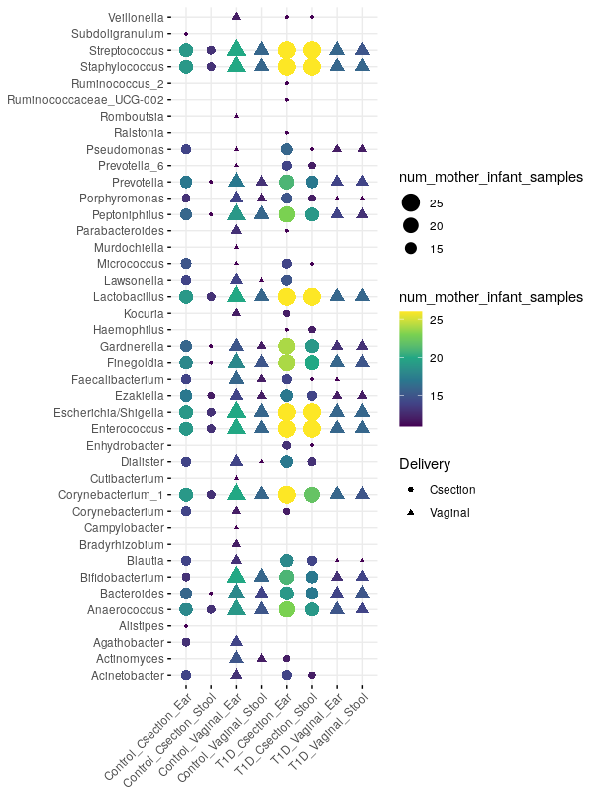
Figure_Taxa_shared_maternal - neonatal dyads
Notes:
41 genera identified in the neonates – transferred from the women; analysed in the maternal-neonatal dyads, presented as numbers of the dyads
Michael, what do you think of modifying this figure (change to %) to make it consistent with the relative abundance of Figure_Microbiota in the 3 vaginal sampling sites?
Figure_Taxa_shared_maternal - neonatal dyads.
The identified 41 genera, common/shared to women and their neonates, presented as numbers of the maternal-neonatal dyads and presented regarding maternal T1D disease status, delivery mode and neonatal sampling site.

Slide 15
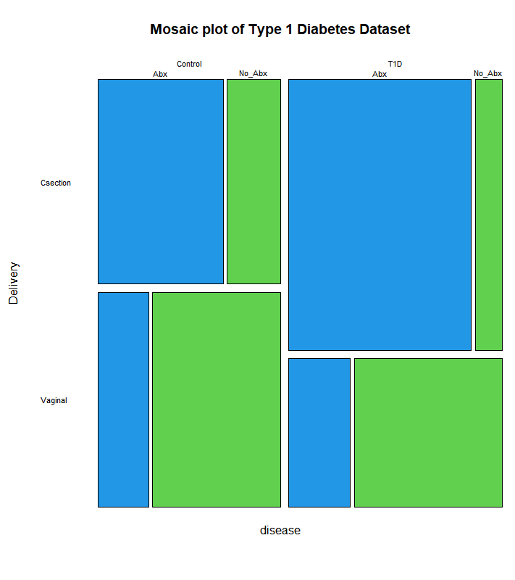
Table_Beta Diversity Bray Curtis adonis permanova
Figure_Mosaic plot of T1D Dataset
C-section vs Vaginal
Table X. Beta Diversity Bray Curtis adonis permanova of VST transformed counts versus Delivery stratified by sample type
 | Df | SumsOfSqs | MeanSqs | F.Model | R2 | Pr(>F)
disease | 1 | 17149 | 17149 | 1.4868 | 0.00968 | 0.0248 | *
Delivery | 1 | 23172 | 23172 | 2.009 | 0.01309 | 0.0008 | ***
disease:Delivery | 1 | 11811 | 11811 | 1.024 | 0.00667 | 0.2259
Residuals | 149 | 1718543 | 11534 |  | 0.97056
Total | 152 | 1770674 |  |  | 1
---
Signif. codes: 0 ‘***’ 0.001 ‘**’ 0.01 ‘*’ 0.05 ‘.’ 0.1 ‘ ’ 1
Antibiotics
Table X. Beta Diversity Bray Curtis adonis permanova of VST transformed counts versus Antibiotics stratified by sample type
 | Df | SumsOfSqs | MeanSqs | F.Model | R2 | Pr(>F)
disease | 1 | 23963 | 23963 | 1.926 | 0.00377 | 0.0003 | ***
Antibiotics_2 | 1 | 19261 | 19261 | 1.5482 | 0.00303 | 0.0013 | **
disease:Antibiotics_2 | 1 | 17335 | 17335 | 1.3933 | 0.00273 | 0.0064 | **
Residuals | 506 | 6295371 | 12441 |  | 0.99047
Total | 509 | 6355930 |  |  | 1
---
Signif. codes: 0 ‘***’ 0.001 ‘**’ 0.01 ‘*’ 0.05 ‘.’ 0.1 ‘ ’ 1
Notes:
Figure_Mosaic plot of T1D Dataset.
The maternal T1D disease status, delivery mode and antibiotic prophylaxis are presented.
Prof. Aagaard: So significance is lost on disease by delivery, but retained on disease by antibiotics. The week of delivery stands in part because of such a strong inverse….no Type I DM goes past 39 weeks (August 13, 2020)
Michael: Removal of the "SampleType" column in the adonis because we are stratifying against it (August 13, 2020)

Slide 16
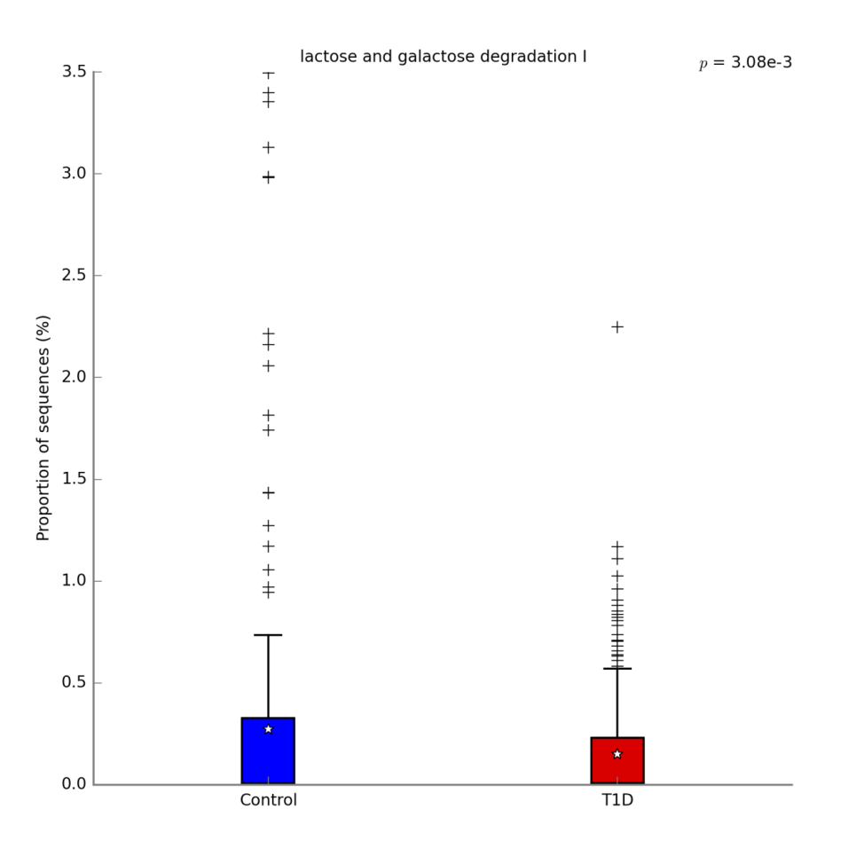
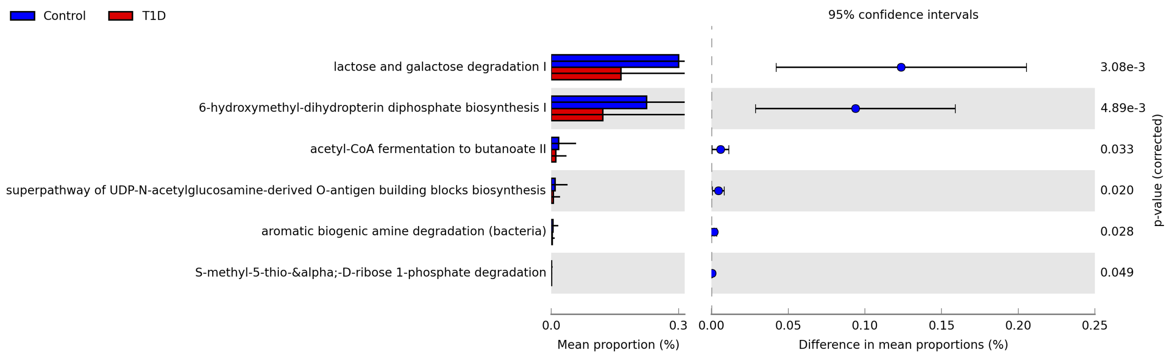
Figure_Pathways_all_samples
Notes:
Figure_Pathways_all_samples.
The PICRUST analysis of combined maternal and neonatal samples.
The most significantly underrepresented predicted pathways (6 out of 18 recognised) in T1D women and their neonates.

Slide 17
Figure_Pathways_Women_rectum swabs_a heatmap?
Notes:
Statistically different_rectum swabs- only 10 vs 165 in the three vaginal sampling sites (a heatmap?)
Figure_Pathways_Women_rectum swabs_a heatmap?
The predicted differently represented pathways in the rectum swabs of women with T1D. The 10 pathways were recognised including 2 pathways from the carbohydrate biosynthesis class. In women with T1D decreased folate biosynthesis (N10-formyl-tetrahydrofolate biosynthesis) was noticed. The SCFA production in the rectum swabs of women with T1D was found lowered (acetyl-CoA fermentation to butanoate II, purine nucleobases degradation I (anaerobic)). The Generation of Precursor Metabolites and Energy (from superpathway of glycolysis and Entner-Doudoroff) was also decreased.

Slide 18
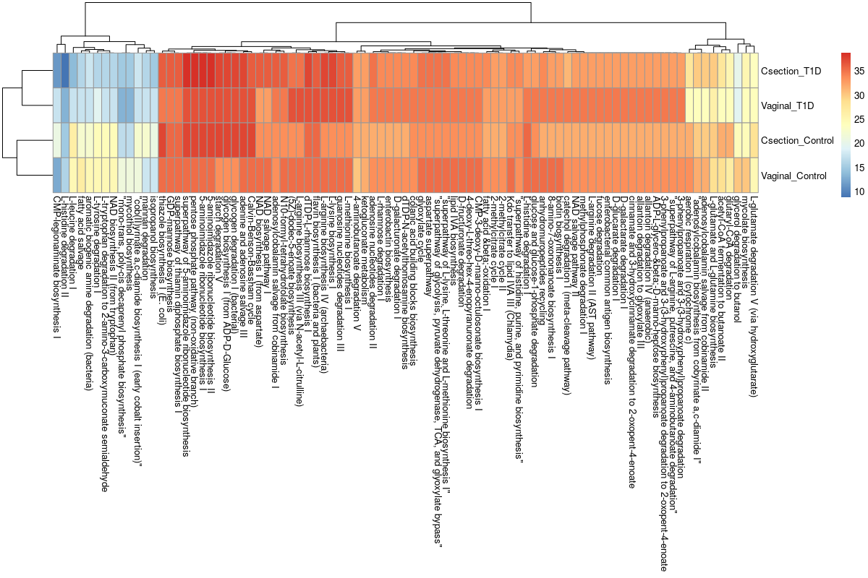
Figure_Top_pathways_shared_maternal - neonatal dyads
% samples in group
Notes:
Maternal samples vs neonatal samples
Figure_Top_pathways_shared_maternal - neonatal dyads.
The top most common predicted to share pathways of samples from maternal - neonatal dyads, presented as percentage of dyads with presence of particular pathway in maternal vaginal sites and neonatal samples. The results indicate that the major covariate driving the clustering is the maternal disease status rather than the mode of delivery.

Slide 19
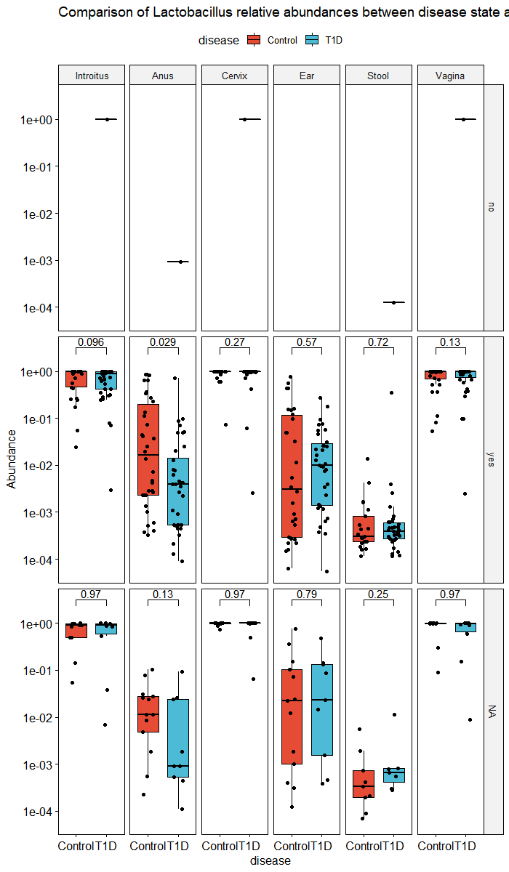
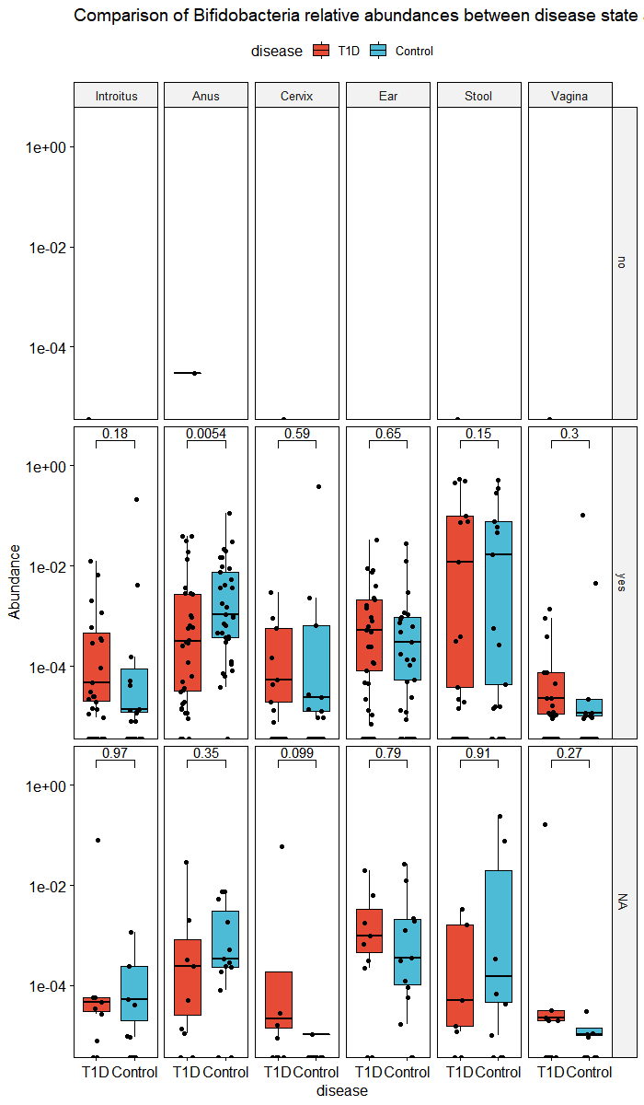
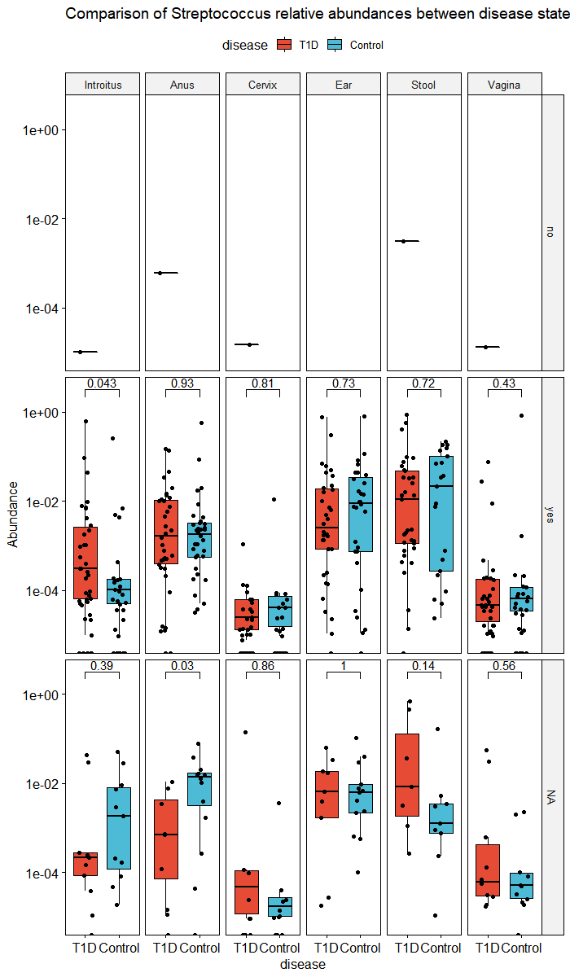
SuppFigure_Comparison of Lactobacillus, Bifidobacterium, and Streptococcus genera rel. abundances by disease and probiotic food products consumed during pregnancy
Notes:
Probiotics taken with food consumed by the women - probiotic food products, a figure to be modified
SuppFigure_Comparison of Lactobacillus, Bifidobacterium, and Streptococcus genera rel. abundances by disease and probiotic food products consumed during pregnancy.
The relative abundances of the selected genera Lactobacillus, Bifidobacterium, and Streptococcus estimated in the particular maternal and neonatal sample. There statistically significant differences in the relative abundance of the genera of Lactobacillus (P=0.029) and Bifidobacterium (P=0.0054) in rectal swabs as well as Streptococcus (P=0.043) in the vaginal introitus samples between women with T1D and unaffected women which declared consumption of the probiotic food products during pregnancy were found.

Slide 20
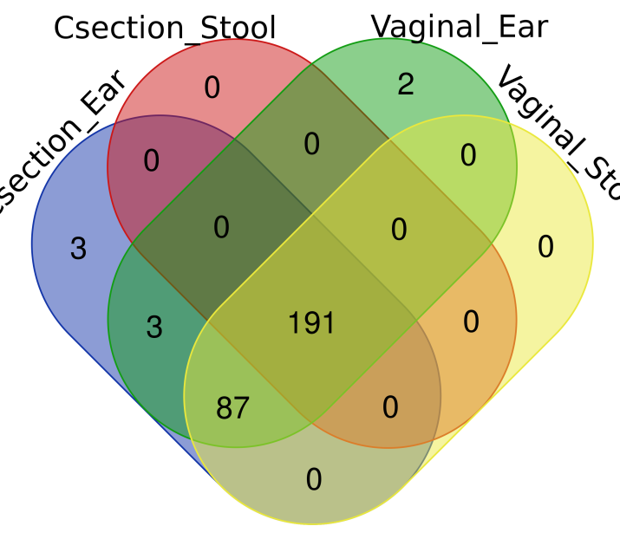

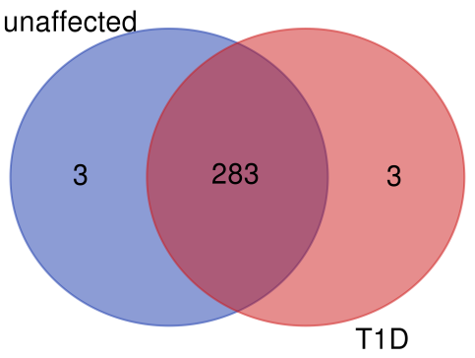
Unaffected mother-neonatal dyads
B.
A.
Mothers with T1D-neonatal dyads
SuppFigure_Venn diagrams_maternal - neonatal dyads
C.
D.
exclusively shared for unaffected dyads
pathway | class | superclass | neonates' sample type
mycothiol biosynthesis | Cofactor, Carrier, and Vitamin Biosynthesis | Biosynthesis | Unaffected_Vaginal_Ear
mono-trans, poly-cis decaprenyl phosphate biosynthesis | Cofactor, Carrier, and Vitamin Biosynthesis | Biosynthesis | Unaffected_Vaginal_Ear
CMP-legionaminate biosynthesis I | Carbohydrate Biosynthesis | Biosynthesis | Unaffected_Csection_Ear
exclusively shared for T1D dyads
pathway | class | superclass | neonates' sample type
2-nitrobenzoate degradation I | Aromatic Compound Degradation | Degradation/Utilization/Assimilation | T1D_Csection_Ear
2-amino-3-carboxymuconate semialdehyde degradation to 2-oxopentenoate | Carboxylase degradation | Degradation/Utilization/Assimilation | T1D_Csection_Ear
superpathway of polyamine biosynthesis II | Amine and Polyamine Biosynthesis | Biosynthesis | T1D_Csection_Ear
Notes:
SuppFigure_Venn diagrams_maternal - neonatal dyads
Results of analysis of metagenomic pathways shared within mother-neonate dyads found in at least 50% dyads of A) unaffected women and B) women with T1D, predicted
using a PICRUSt bioinformatics software package.
Each prediction of a specific metagenomic pathway common to one of the maternal sample types and one of the neonatal sample types was counted in the maternal - neonatal dyads (the ear-skin swab from Csection born neonates, ear-skin swab from Vaginally delivered neonates, stool samples from Csection born neonates, and stool samples from Vaginally delivered samples were assessed separately).
The 191 pathways from unaffected mother-neonatal dyads and 270 pathways from mother with T1D-neonatal dyads were shared regardless the delivery mode and neonatal sample type.
The 79 out of 87 pathways predicted in the vaginally and Csection delivered neonates’ ear-skin swabs and vaginally delivered neonates’ stool samples in the unaffected mother-neonatal dyads (A) were also predicted in both Csection and vaginally delivered born neonates’ samples in the mother with T1D-neonatal dyads.
The analysis, independently of neonates’ sample type (C) showed 283 predicted metagenomic pathways shared in the all studied dyads.
Three biosynthesis pathways were predicted as exclusively shared within unaffected mother-neonatal dyads (D), while three pathways were predicted as exclusively shared within mother with T1D-neonatal dyads.

Slide 21
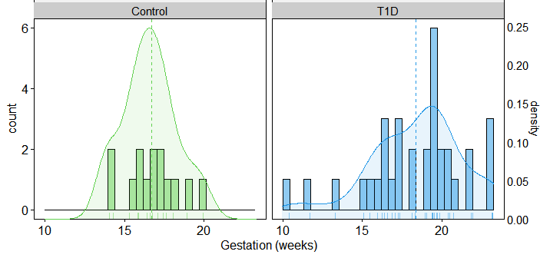
Beta Diversity Bray Curtis adonis permanova
% energy from protein
Table X. Beta Diversity Bray Curtis adonis permanova of VST transformed counts versus percent energy derived from protein stratified by sample type
 | Df | SumsOfSqs | MeanSqs | F.Model | R2 | Pr(>F)
disease | 1 | 23207 | 23207 | 1.9412 | 0.00728 | 0.0001 | ***
energ_bialko_proc_2 | 1 | 16539 | 16539 | 1.3835 | 0.00519 | 0.002 | **
disease:energ_bialko_proc_2 | 1 | 17810 | 17810 | 1.4898 | 0.00558 | 0.0027 | **
Residuals | 262 | 3132107 | 11955 |  | 0.98196
Total | 265 | 3189663 |  |  | 1
Signif. codes: 0 ‘***’ 0.001 ‘**’ 0.01 ‘*’ 0.05 ‘.’ 0.1 ‘ ’ 1
Notes:
2 in 1
SuppFigure_energy_prot_Beta diversity.
The Beta Diversity PCoA plots presenting the T1D and control samples’ microbial composition across all studied sample types regarding the percentage of energy derived from protein.
SuppTable_energy_prot_Beta diversity.
Beta Diversity Bray Curtis adonis permanova of VST transformed counts versus the percentage of energy derived from protein, stratified by sample type.
The influence of the percentage of energy derived from protein on maternal and neonatal microbiota composition was found, regardless of the T1D disease status (P=0.002). Also, combined, the disease and energy derived from proteins, influenced the microbiota composition (P=0.0027).

